Slide 1
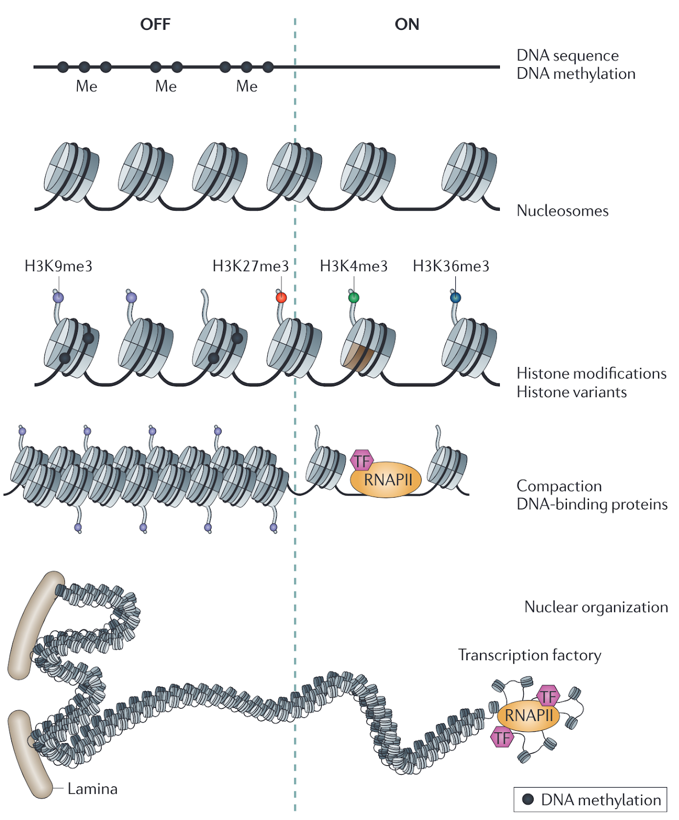
Notes:
Figure 1 | Chromatin structure hierarchy of eukaryotes. Chromatin configuration significantly affects the gene transcription states (active or repressed). From top to bottom, DNA can be methylated (Me) on cytosine. DNA wraps around the histone to form the
nucleosome, the fundamental unit of chromatin. Histones can be modified at multiple peptide sites with multiple modifications, where these modifications greatly impact the accessibility of DNA to transcription complexes. Chromatin can also organise into higher-order structures. Figure was adapted from (14).

Slide 2
Notes:
Figure 2 | An overview of different protein-DNA binding site mapping methods. From left to right, target sites are crosslinked and fragmented with sonication in ChIP-seq, which results in a low resolution. The enzyme tethering methods enable an in situ profiling. In CUT&RUN, fusion protein pA-MNase is added to the permeabilized nuclei subsequent to the primary antibody. It is activated with calcium ions on ice to cleave the DNA at target sites. Still, these fragments need to be polished and add adapters for the sequencing library. CUT&Tag replaces the MNase with Tn5 enzyme and enables tagmentation after cleavage. Further, TIP-seq adds a T7 promoter in tagmentation and thus allows a linear amplification of the sequencing library. All the fragments from these protein-DNA binding site mapping methods were sequenced with next generation sequencing (NGS). The sequenced reads were trimmed, filtered, and aligned to the reference genome with or without removal of duplication. The statistically enriched regions, termed “peaks”, were identified with peak caller.

Slide 3
A
B
C
D
E
F
Notes:
Figure 3 | Peak calling and comparison strategies. A and B. Peaks were called by identifying whether a region is statistically enriched compared to the negative control IgG (background). C. Comparison of mapping outcomes can be performed on read level. Read intensity in each bin was summed, with the Pearson correlation calculated across the whole genome. D. Rather than calculate the Pearson correlation across the whole genome, the “significant enrichment” strategy only calculates the Pearson correlation on the reference peak region. E. Peak comparison. F. Potential underestimation of binding similarities with the peak level comparison. The stringent peak calling threshold due to the multiple testing correction obtains only the best peaks. Regions with substantial enrichment are excluded and thus leads to an underestimation of binding similarity.

Slide 4
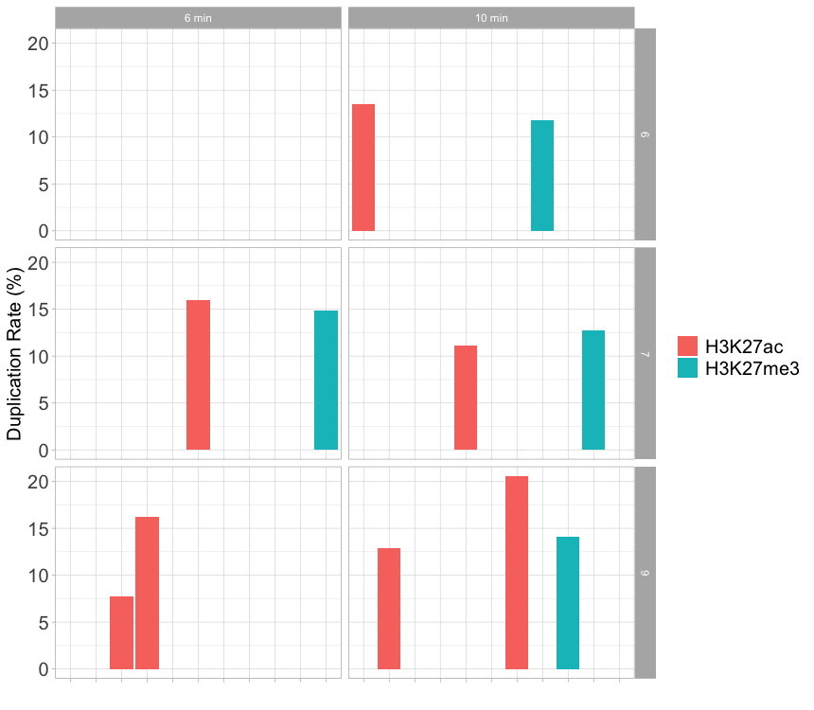
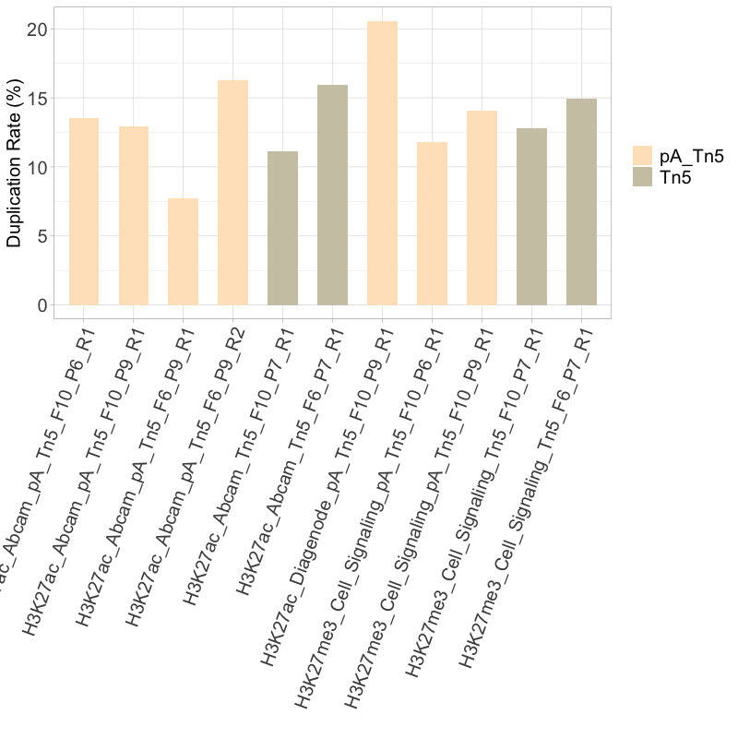
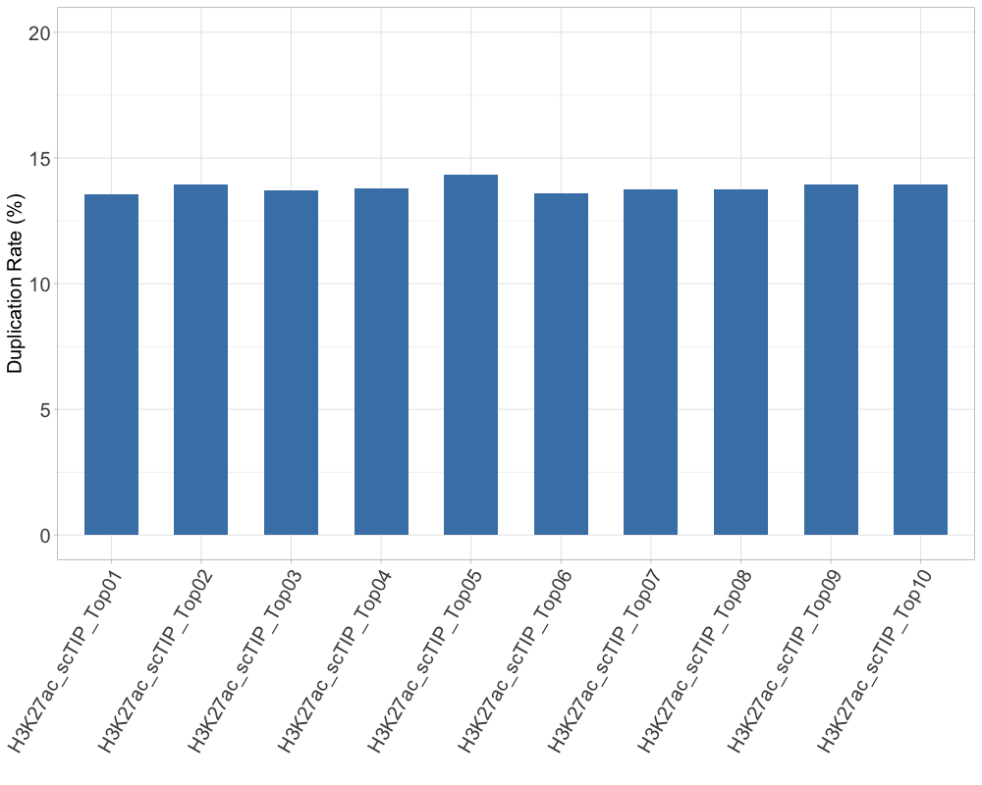
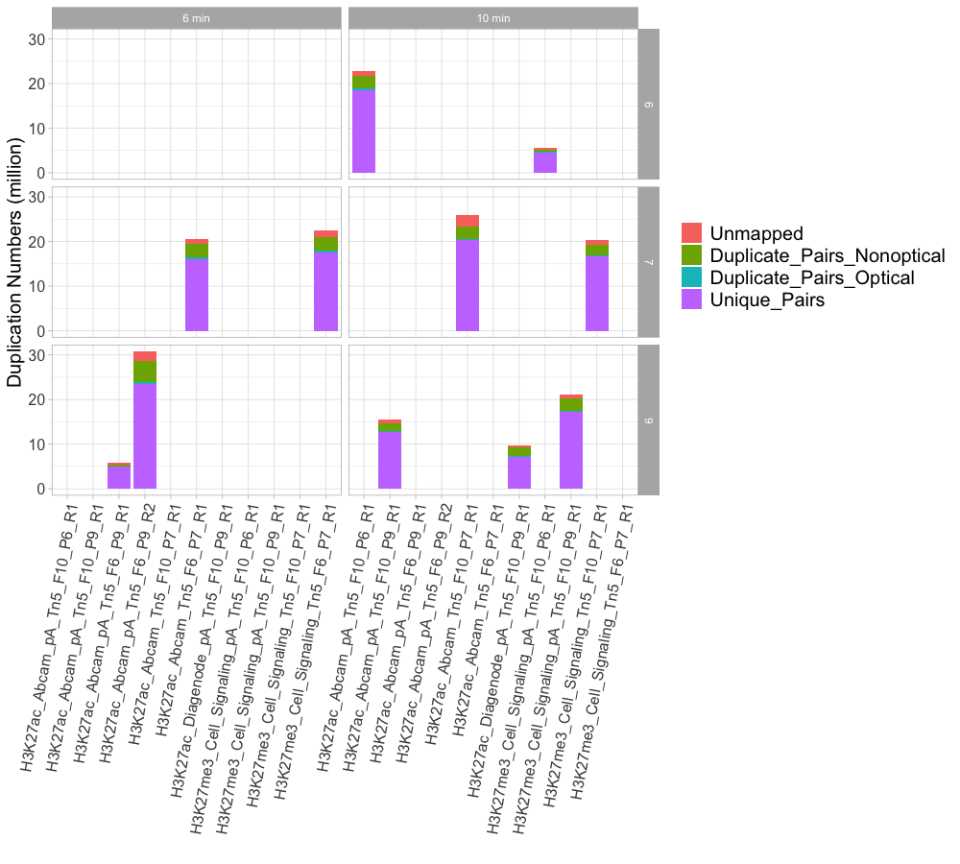
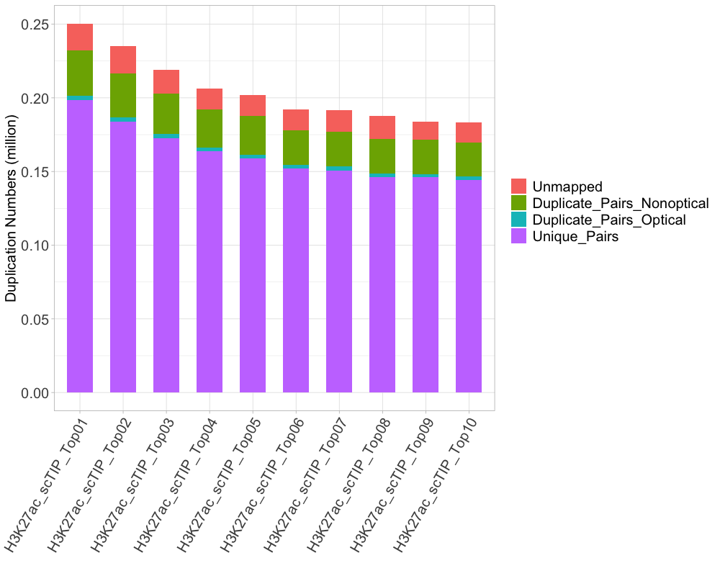
A
B
C
D
E
Notes:
Figure 4 | Duplication rates and distribution. A. Duplication rates of bulk samples treated with different tagmentation time and PCR amplification cycle. B. Duplication rates of bulk samples treated with fusion pA-Tn5 and Tn5 alone. C. Duplication rates in single-cell H3K27ac samples. D and E. Duplication distribution in bulk and single-cell samples.

Slide 5
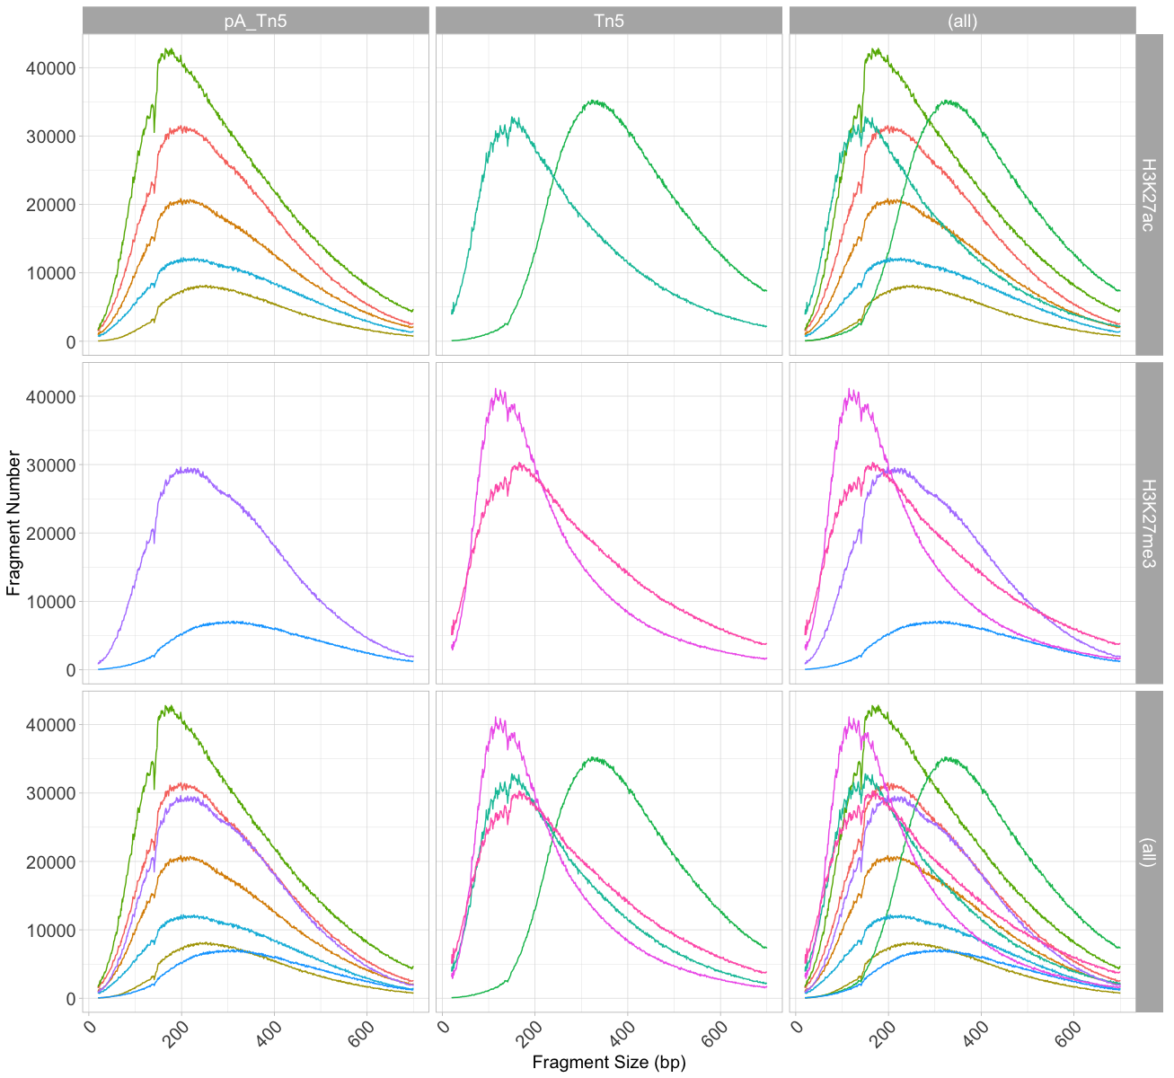
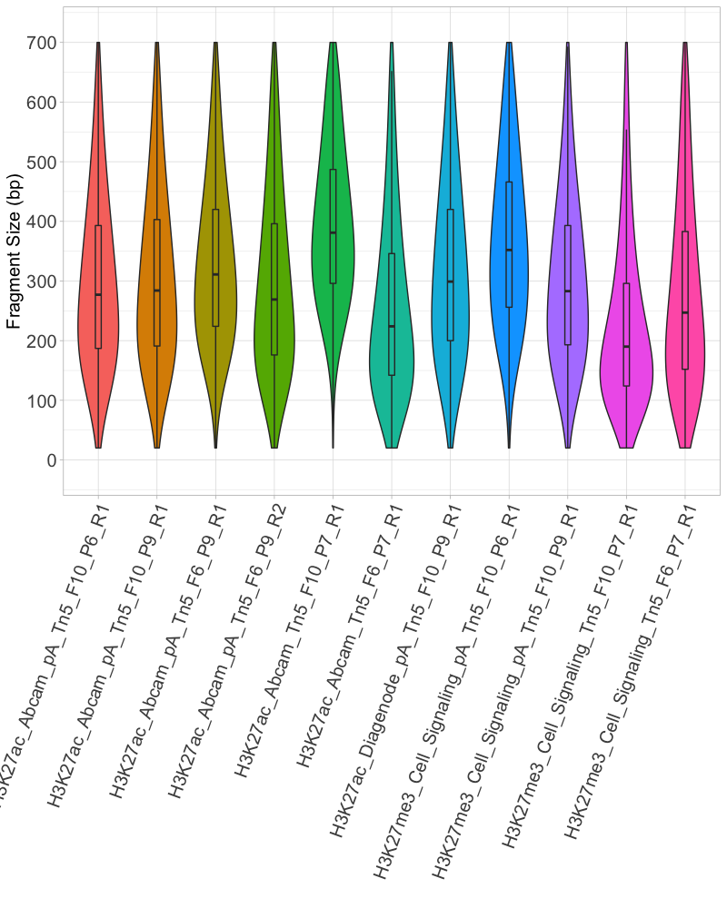
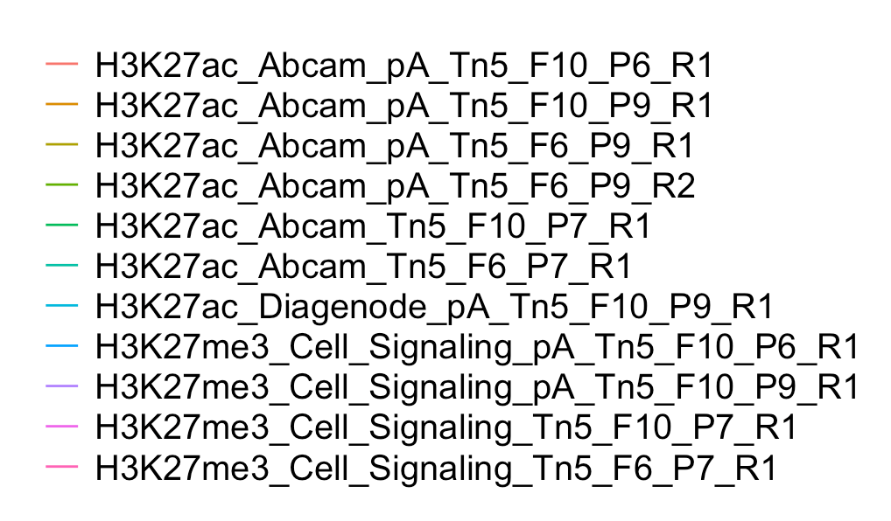
A
B
Notes:
Figure 5 | Quality control: TIP-seq fragment size distributions. A. Overall fragment size distribution. B. Violin plot of the fragment size.

Slide 6
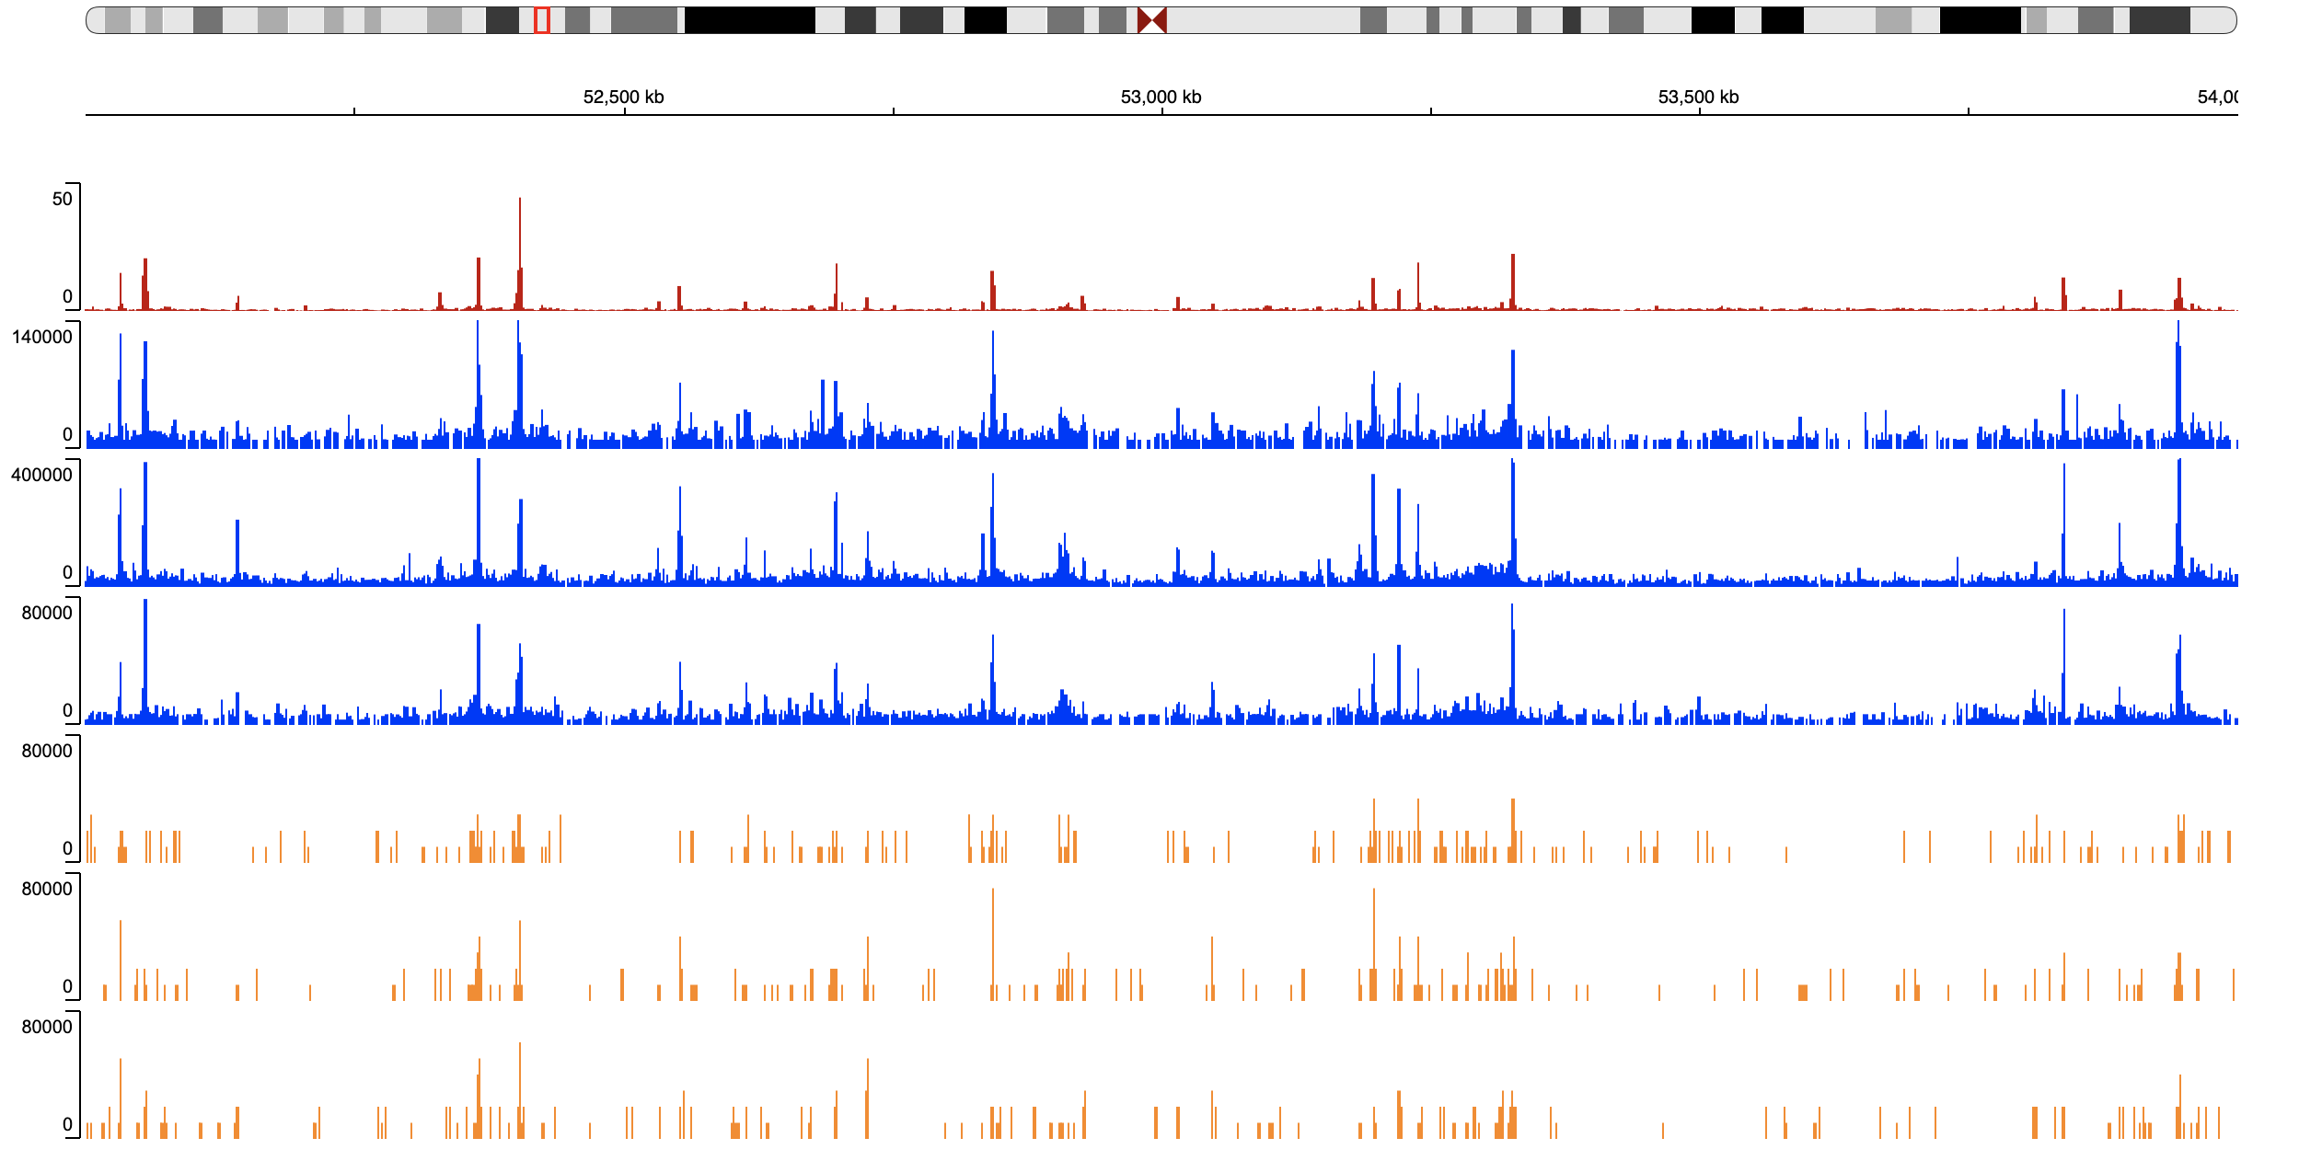
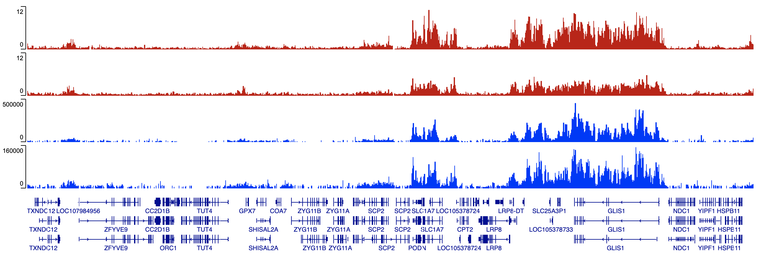
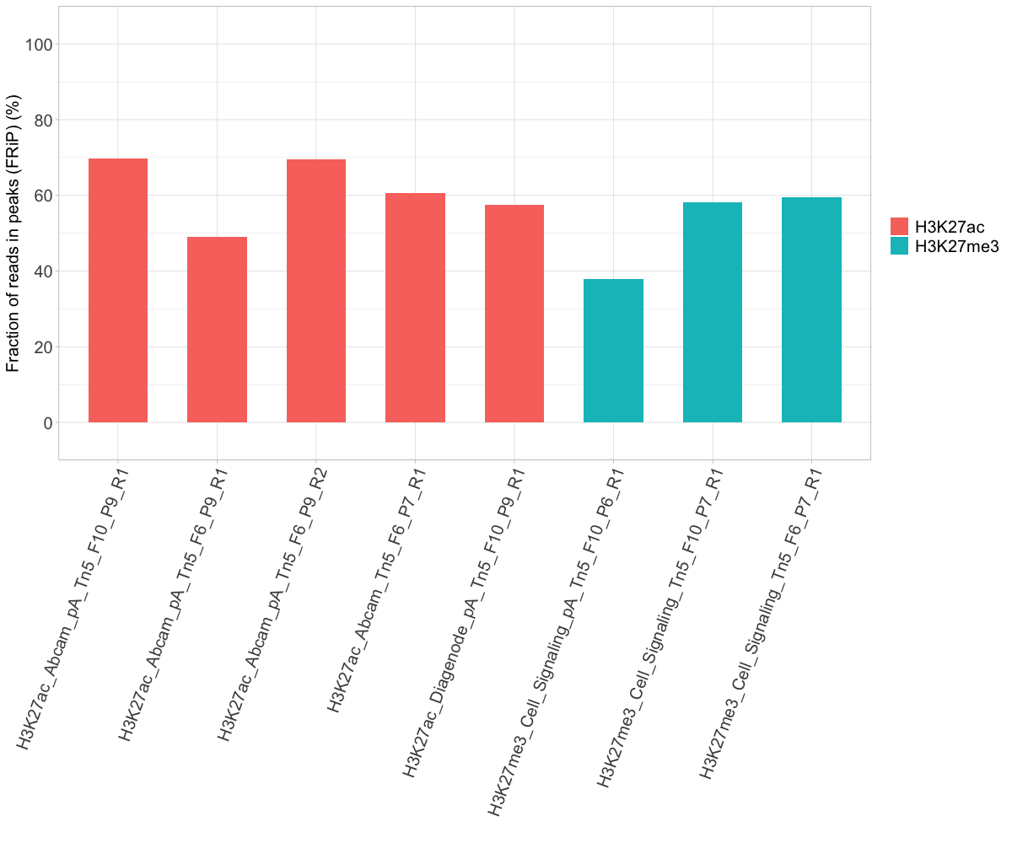
A
Chromosome 1 52,000,000 : 56,000,000
H3K27ac
ENCODE Broad
Abcam_pA_Tn5_F6_P9_R1
Abcam_Tn5_F6_P7_R1
Diagenode_pA_Tn5_F10_P9_R1
scTIP_Top01
scTIP_Top02
scTIP_Top03
H3K27me3
ENCODE USC
ENCODE Broad
Cell_Signaling_pA_Tn5_F10_P9_R1
Cell_Signaling_Tn5_F6_P7_R1
Refseq Genes
B
Notes:
Figure 6 | TIP-seq for histone modification profiling. A. Representative chromatin landscapes across a 4 Mb segment of the human genome generated by Integrative Genomics Viewer (IGV) (55). Of note, for the ENCODE file, the fold change compared to the background is presented. Since there is no negative control included in our benchmark, the sum of read counts are presented for TIP-seq files. B. Fractions of Reads in Peaks (FRiPs) of TIP-seq.

Slide 7
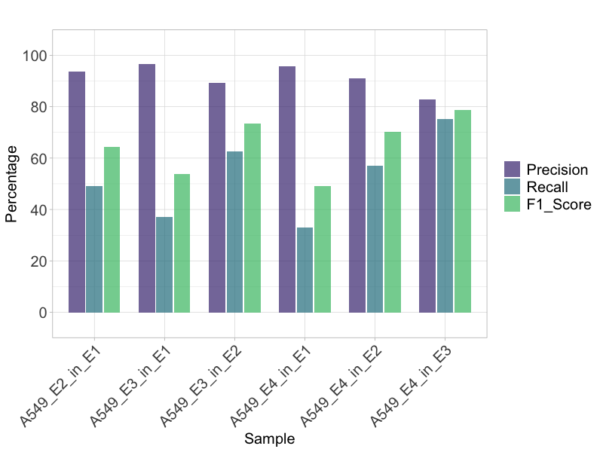
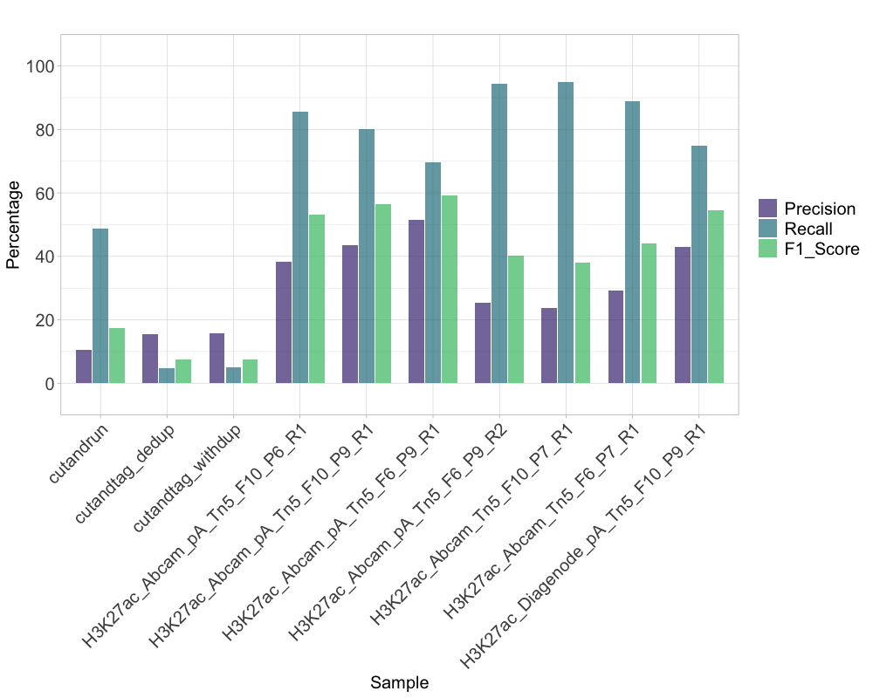
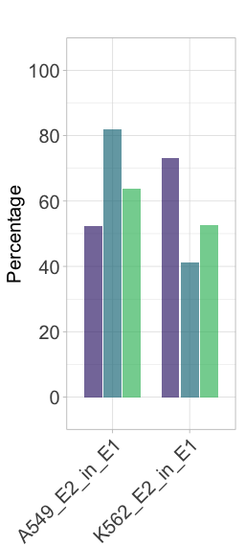
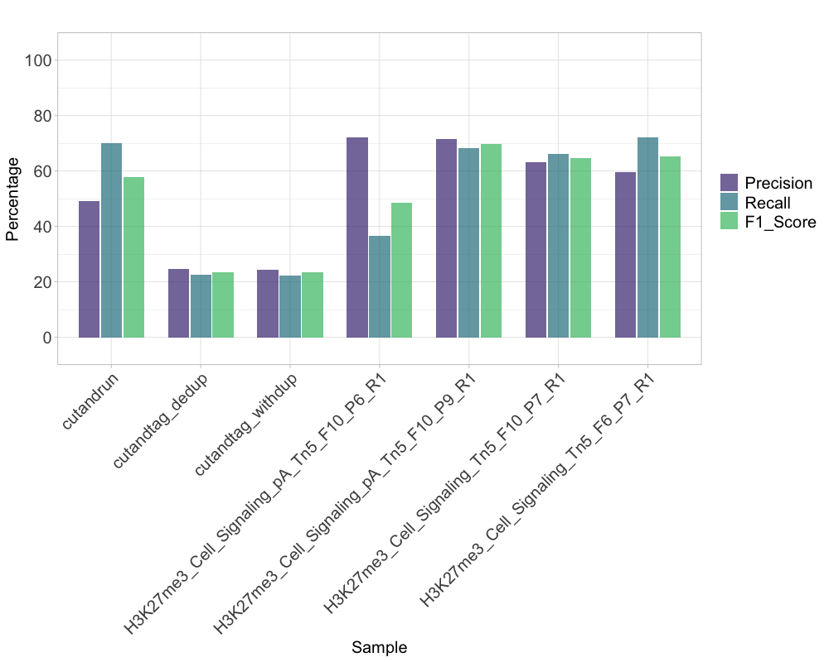
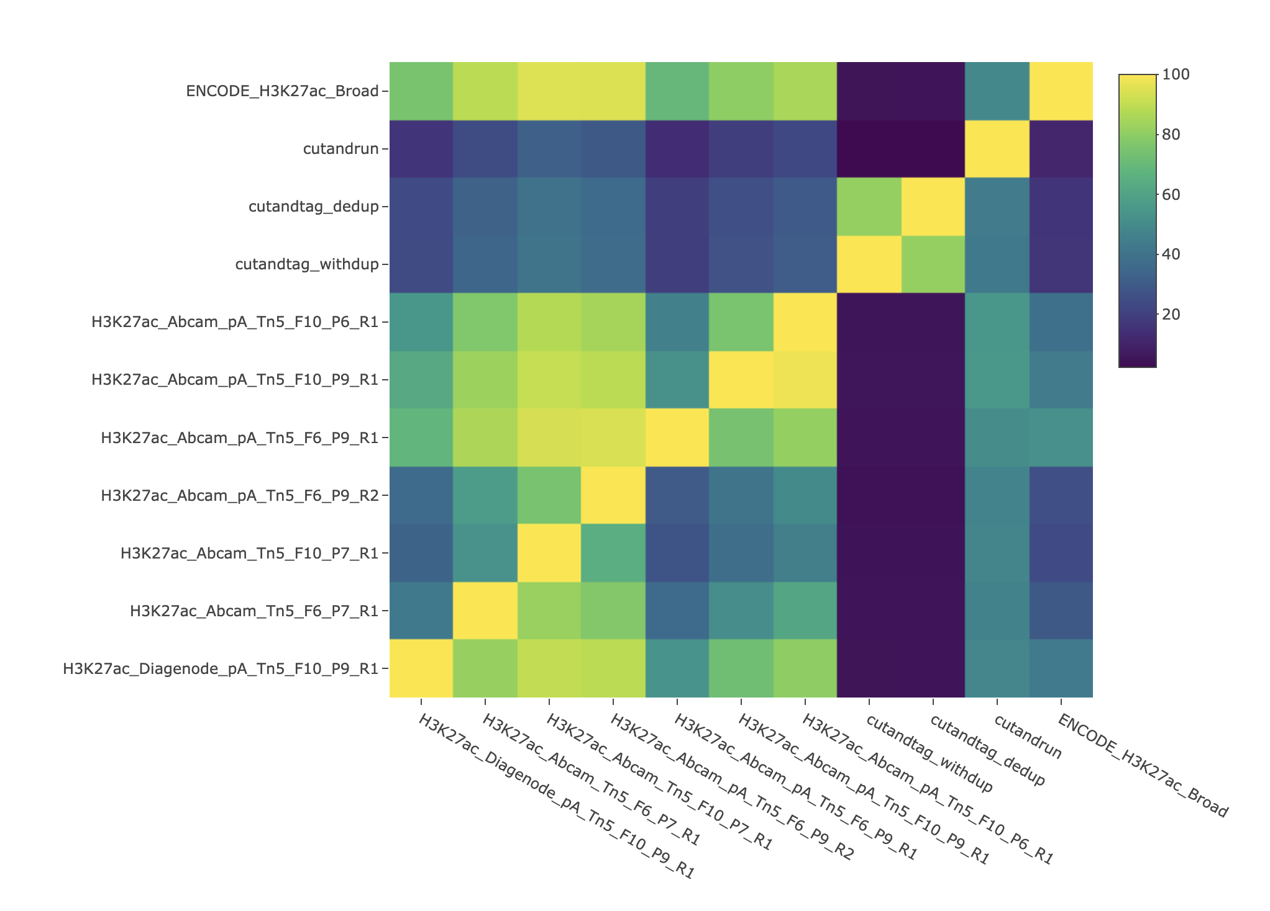
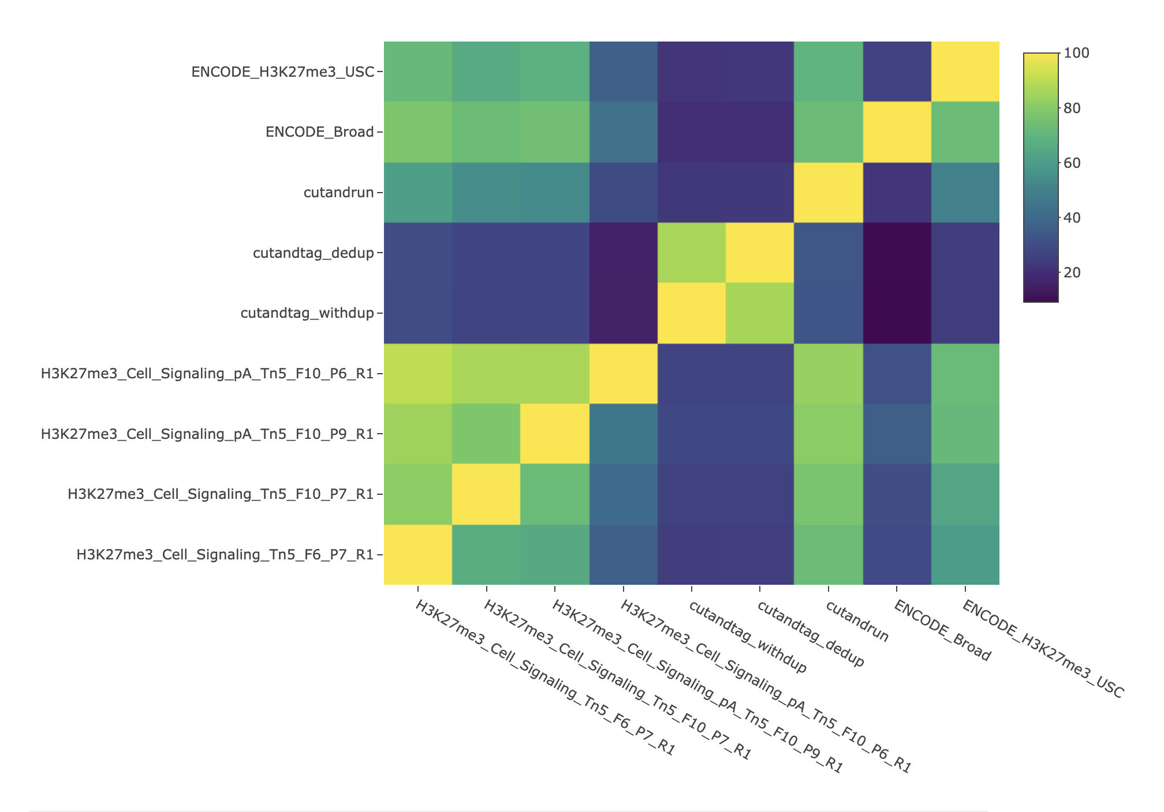
A
B
C
D
E
F
Notes:
Figure 7 | Benchmark of TIP-seq peaks against ENCODE ChIP-seq reference (bulk). A. Peak overlap baseline between the 4 ENCODE reference on H3K27ac in A549 cell line, as there is only one ENCODE reference dataset available for the K562 cell line on H3K27ac. B. H3K27ac peak overlap of CUT&RUN, CUT&Tag and TIP-seq with the ENCODE reference. C. Peak overlap baseline between the 4 ENCODE references on H3K27me3 (2 in A549 cell line, 2 in the K562 cell line). D. H3K27me3 peak overlap of CUT&RUN, CUT&Tag and TIP-seq with the ENCODE reference. E and F. Heatmap of pairwise peak comparison. The y-axis is the reference.

Slide 8
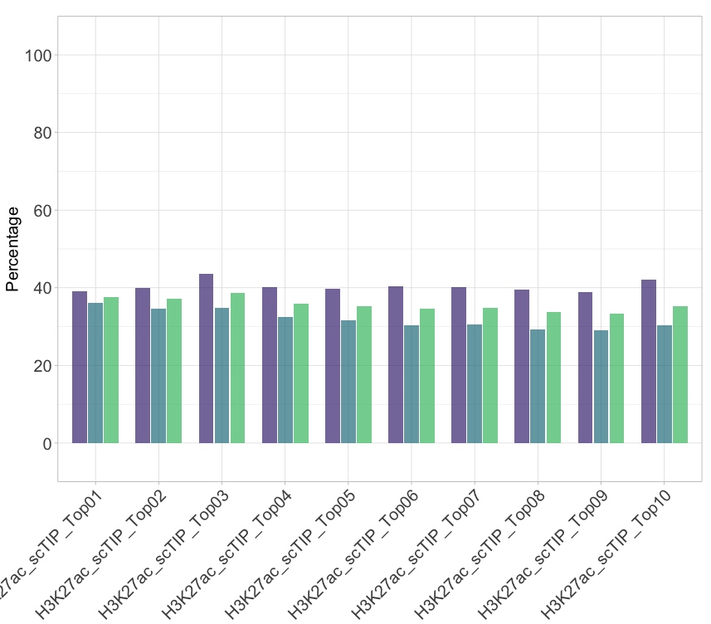
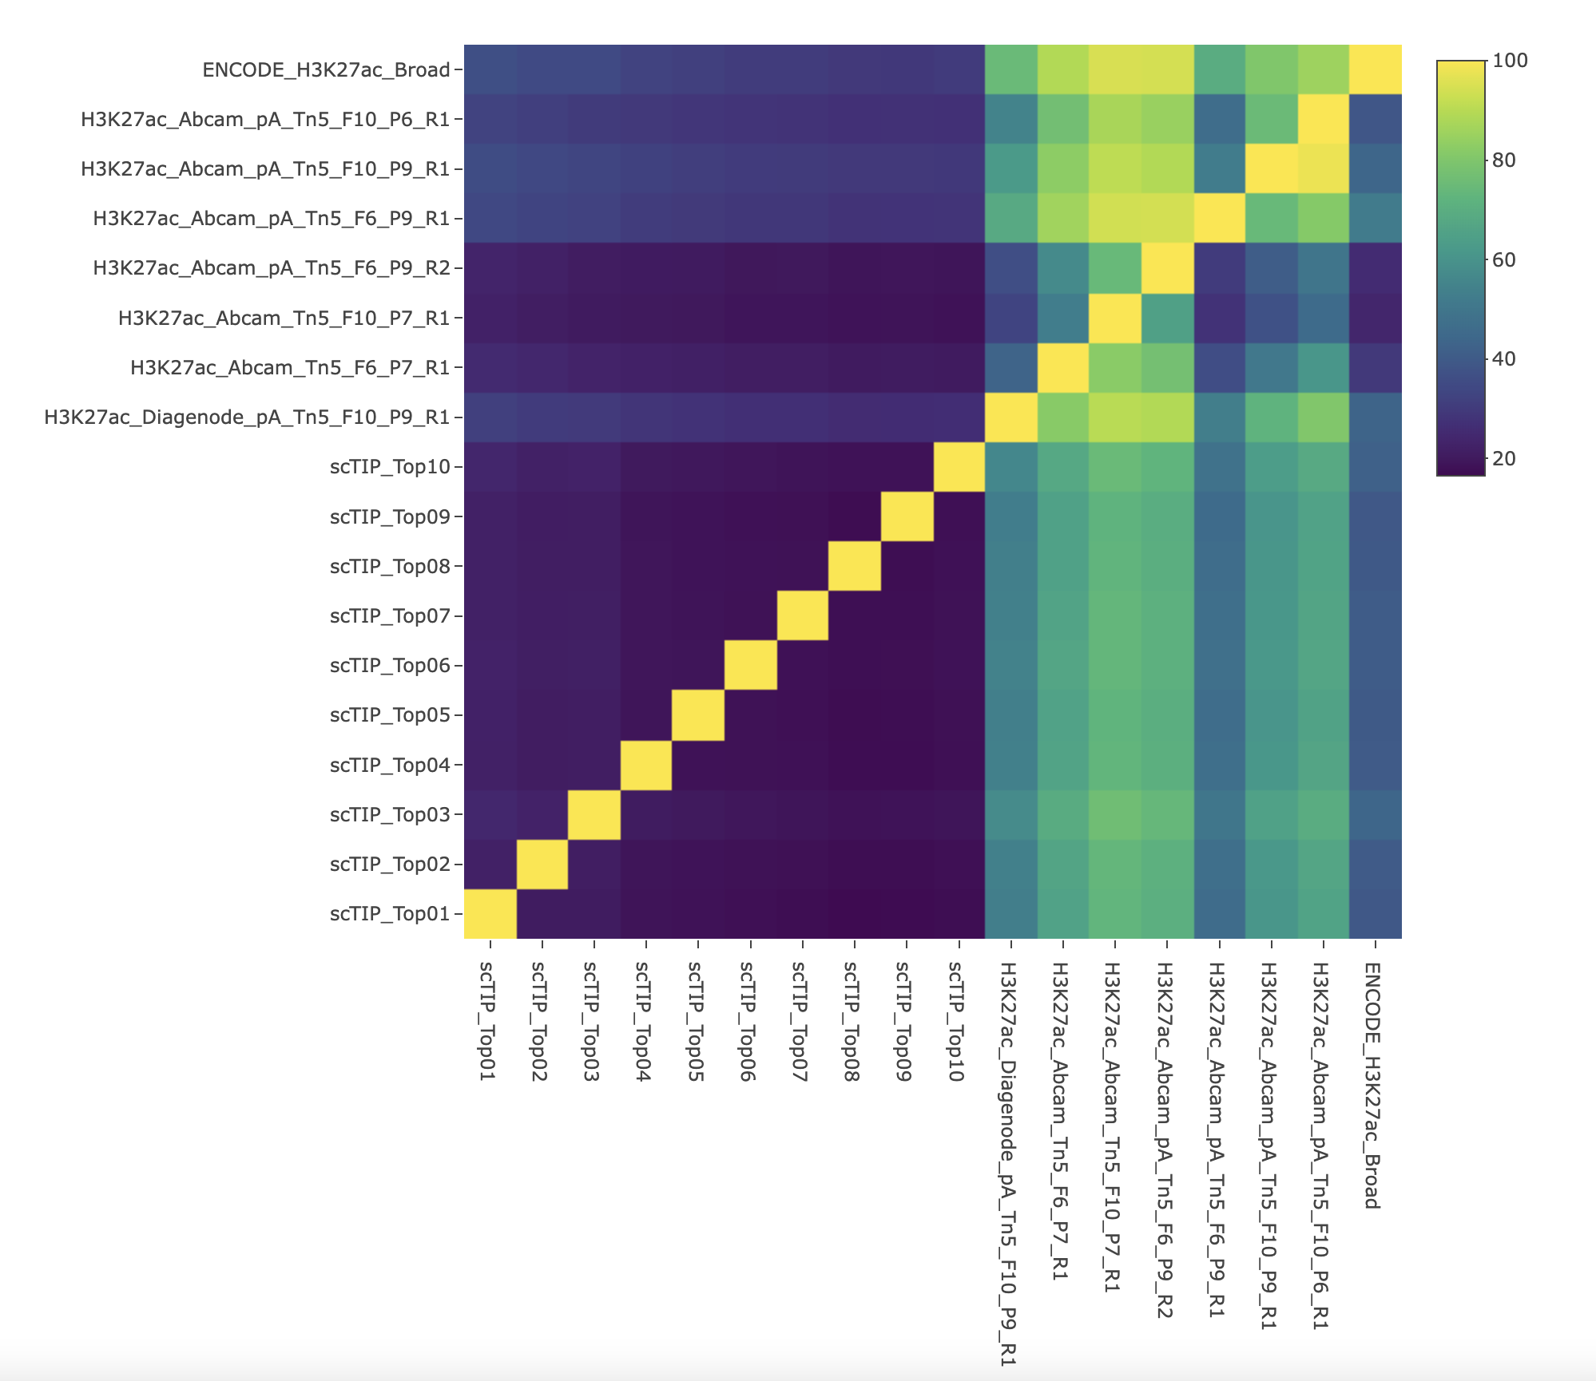
A
B
C
Notes:
Figure 8 | Benchmark of TIP-seq peaks against ENCODE ChIP-seq reference (single cell). A. Peak overlap baseline between the 4 ENCODE reference on H3K27ac in A549 cell line. B. Benchmark of single-cell TIP-seq peaks against the ENCODE reference on H3K27ac. C. Heatmap of pairwise peak comparison. The y-axis is the reference.

Slide 9
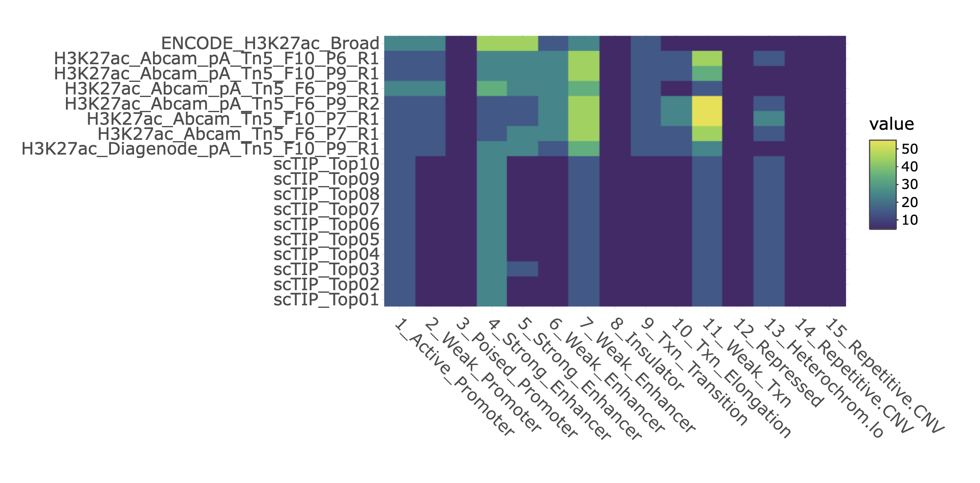
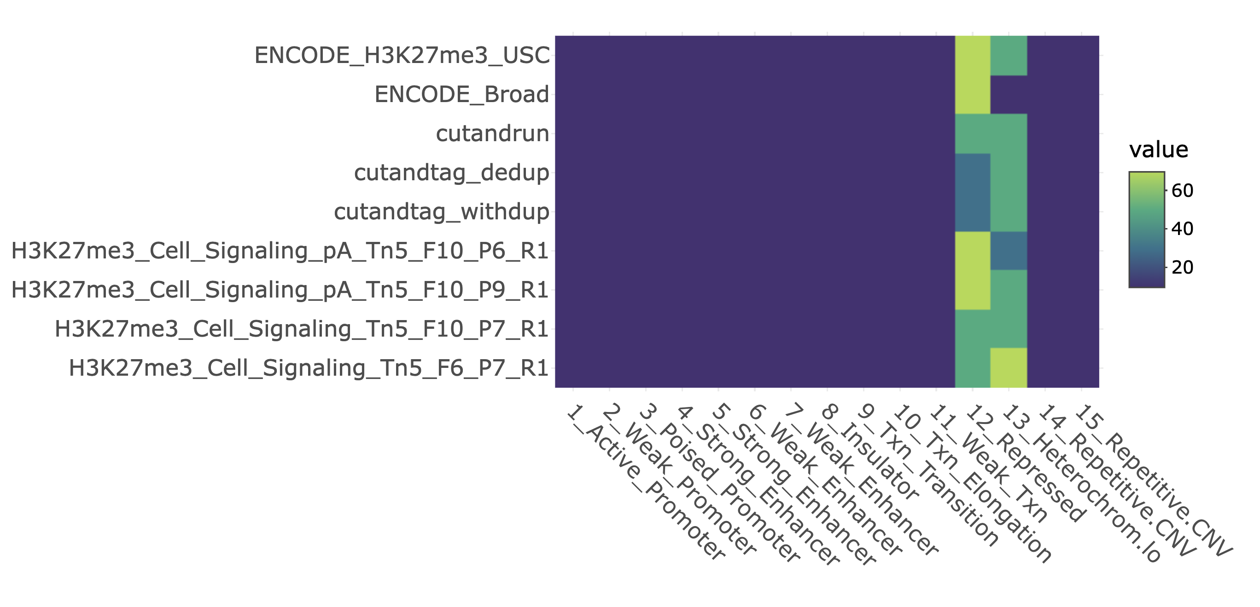
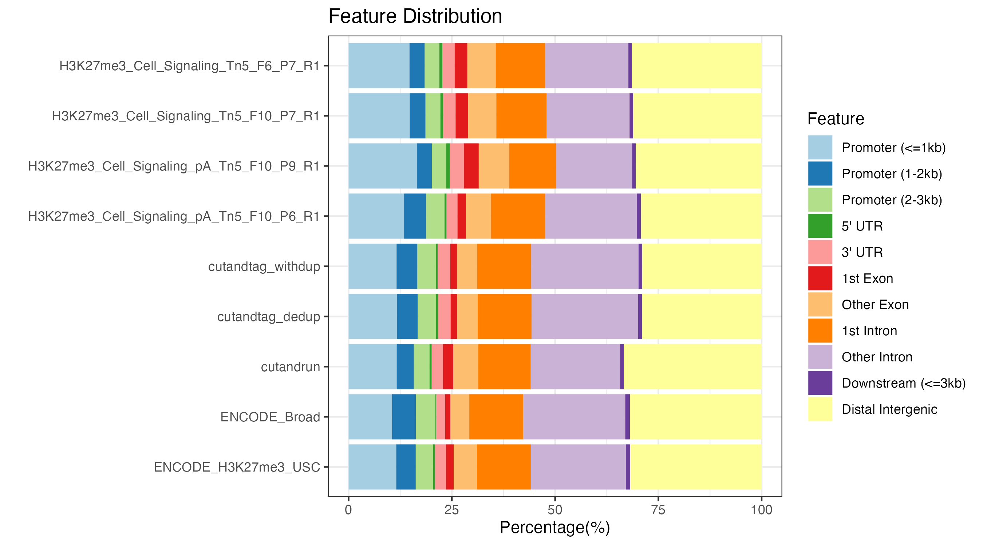
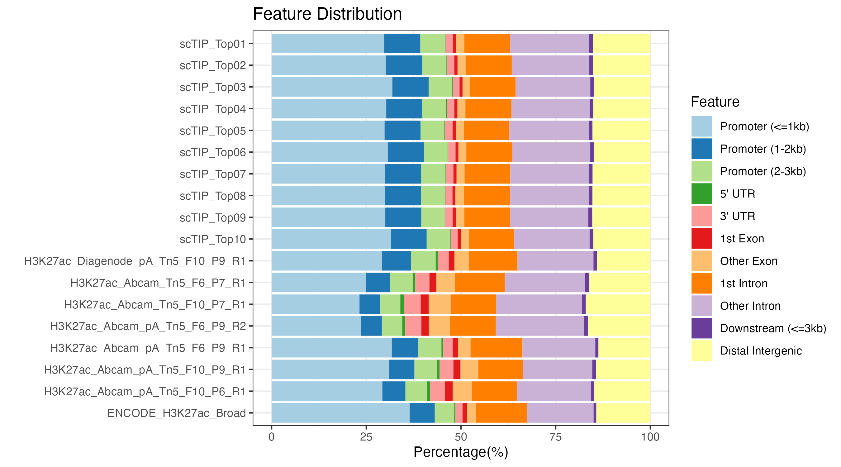
A
B
C
D
Notes:
Figure 9 | Genomics distribution and chromatin states of TIP-seq and ENCODE reference peaks. A and B. Chromatin annotation of the H3K27ac and H3K27me3 peaks, respectively. C. ChIPseeker characterisation of peaks with regulatory elements on H3K27ac. D. ChIPseeker characterisation of peaks with regulatory elements on H3K27me3.

Slide 10
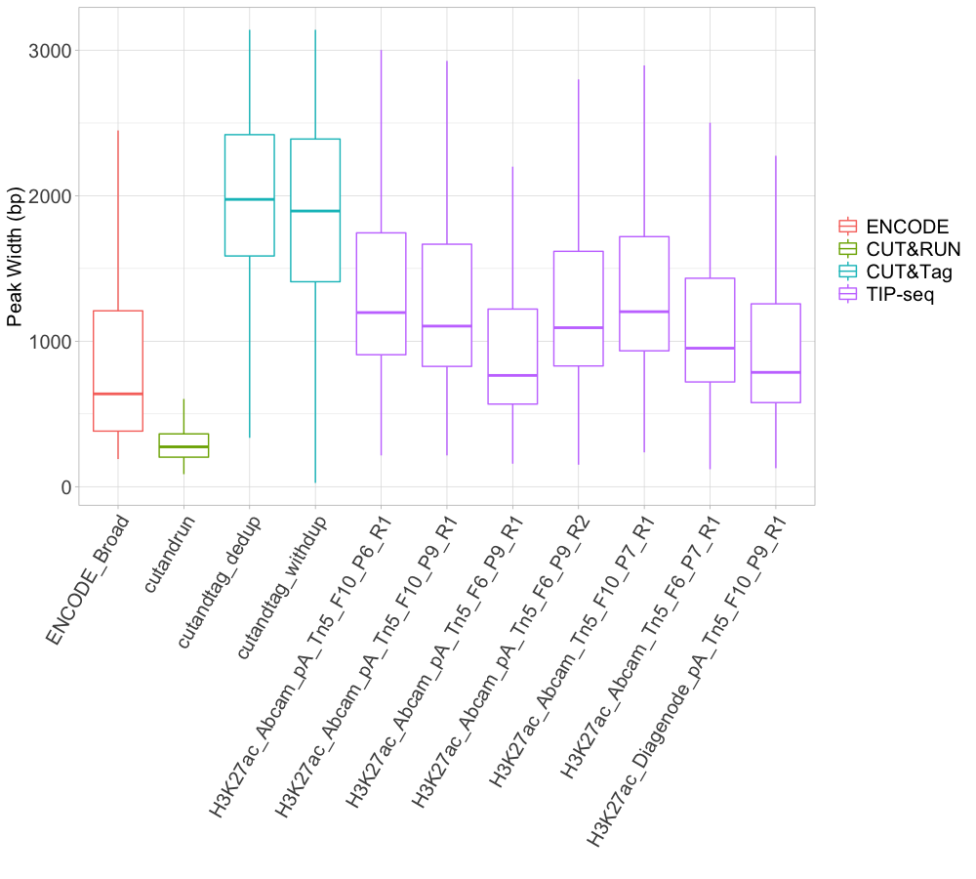
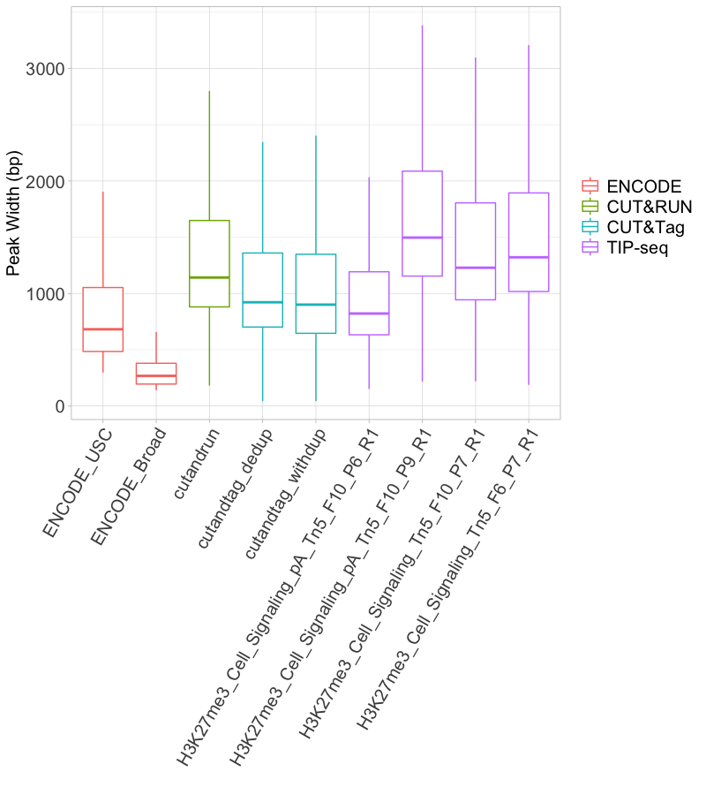
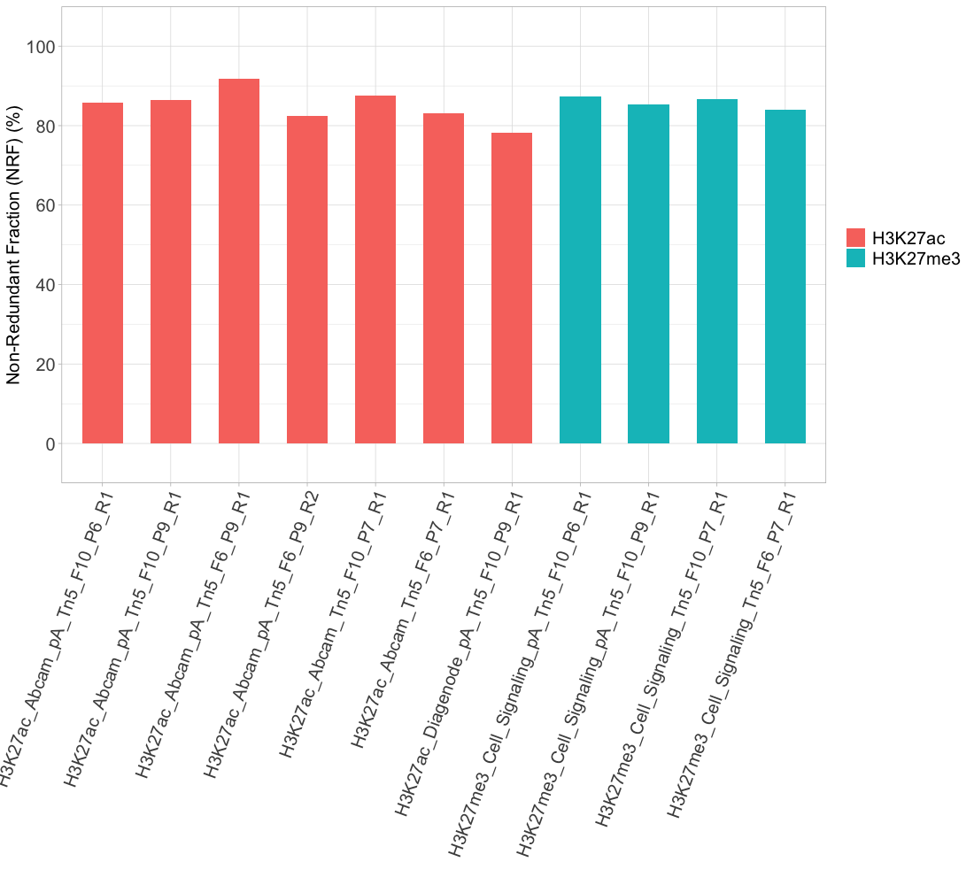
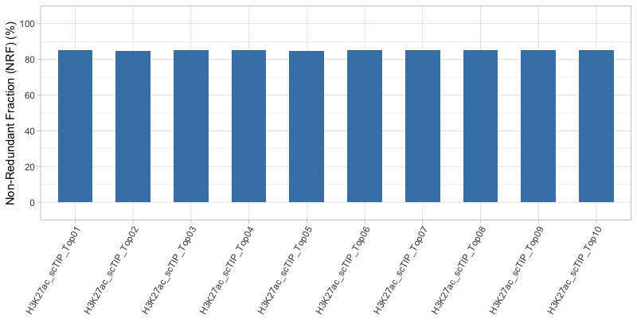
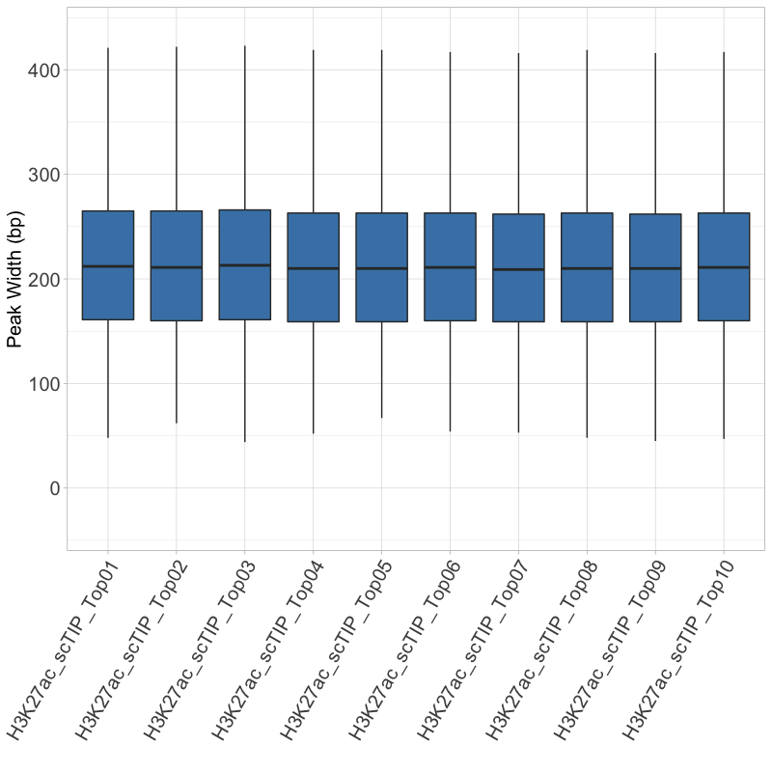
A
B
C
D
E
Notes:
Supplementary Figure 1. Peak width distribution and Non-Redundant Fraction (NRF). A and B. Peak width distribution on H3K27ac and H3K27me3. C. NFR across the bulk TIP-seq samples. D. Single-cell TIP-seq NFR. E. Single-cell TIP-seq peak width distribution.

Slide 11
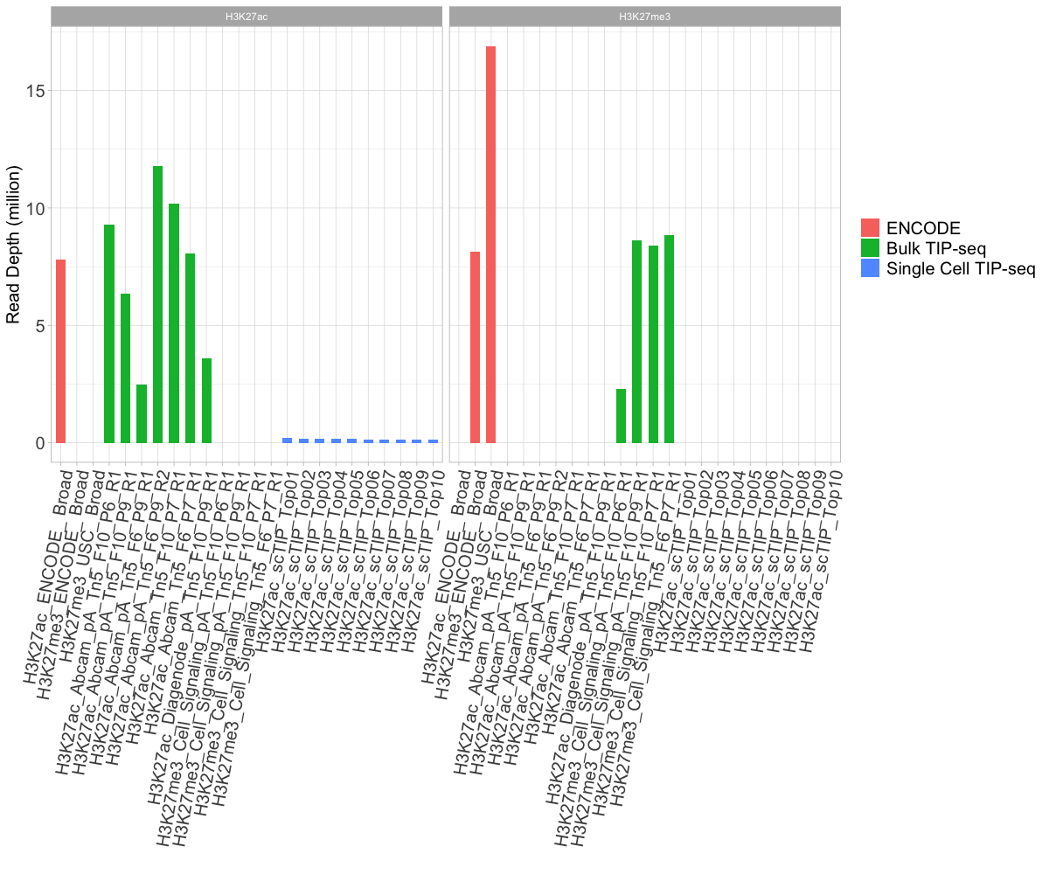
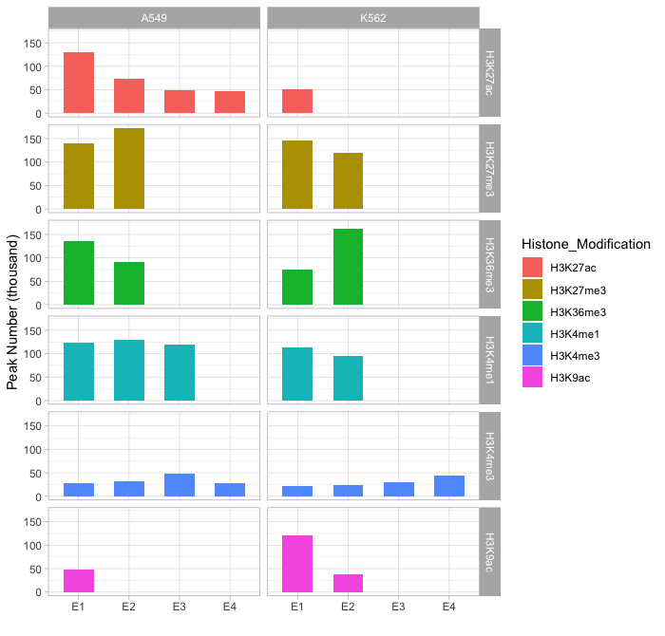
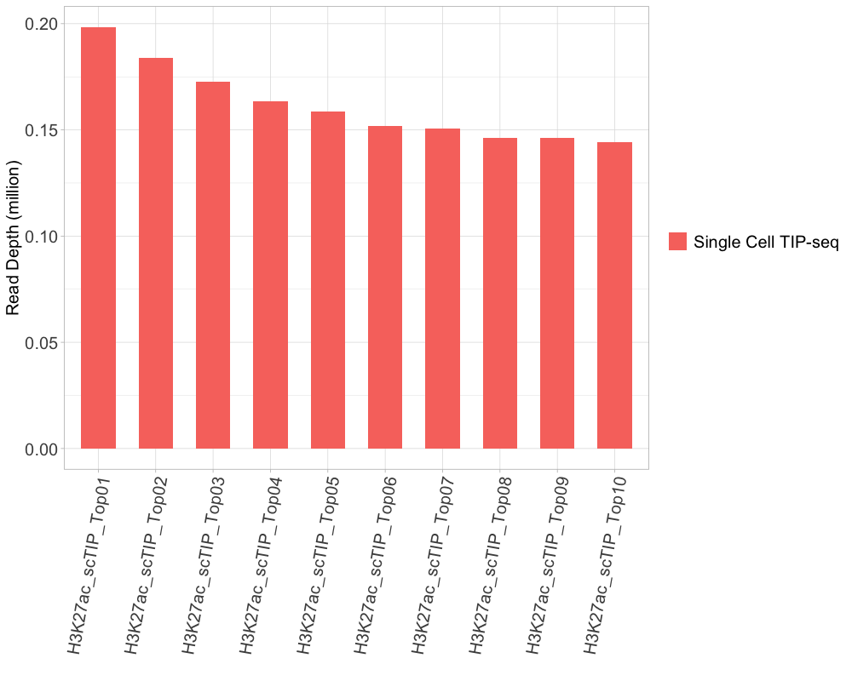
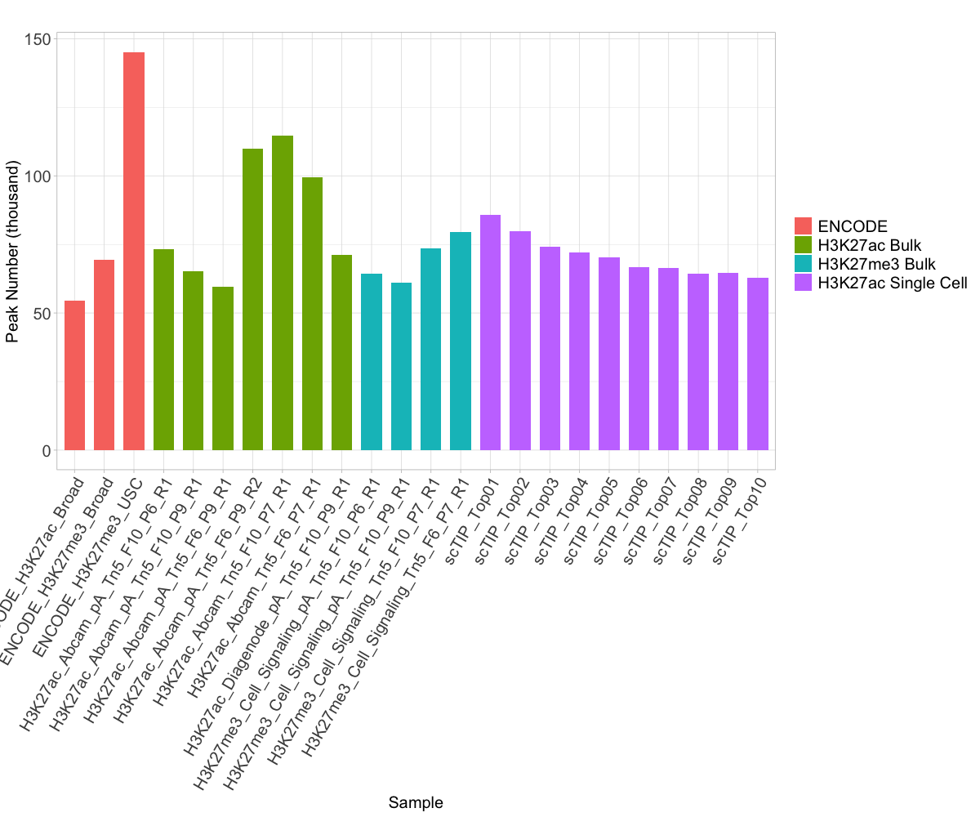
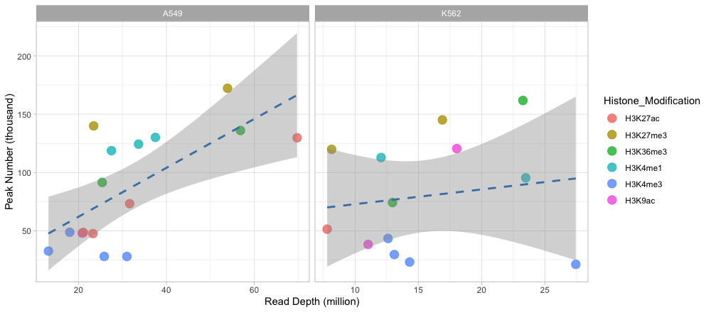
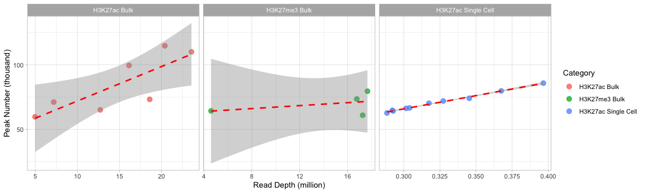
A
B
C
D
E
F
Notes:
Supplementary Figure 2. Correlation between peak number and read depth. A. TIP-seq peak numbers. B. ENCODE ChIP-seq peak numbers. 4 additional histone modifications were introduced (H3K4me1, H3K4me3, H3K36me3 and H3K9ac) for checking the correlation between read depth and peak number, and for future benchmark on these histone marks. C. TIP-seq single-cell read depth. D. TIP-seq and ENCODE ChIP-seq peak number. E and F. Correlation between read depth and peak number of TIP-seq and ENCODE ChIP-seq.

Slide 12
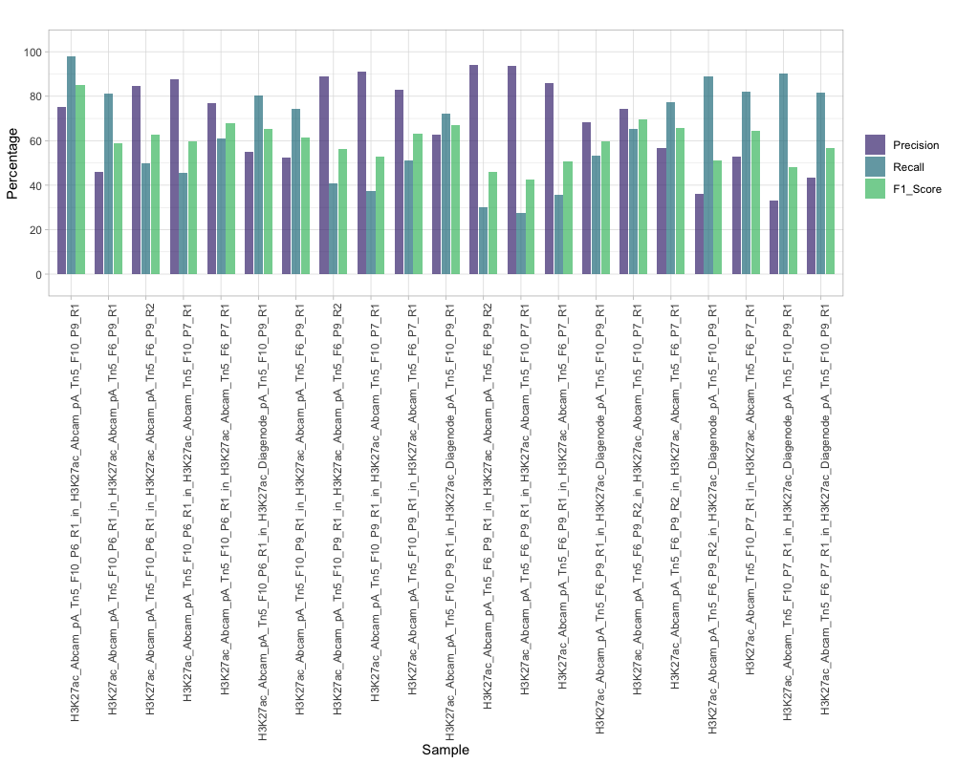
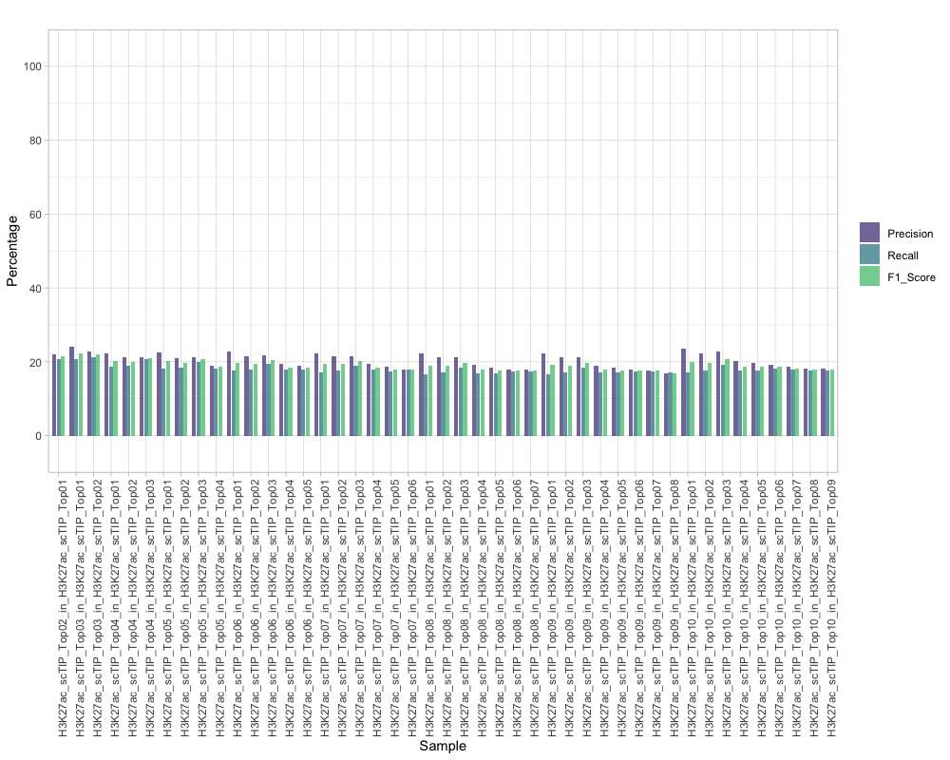
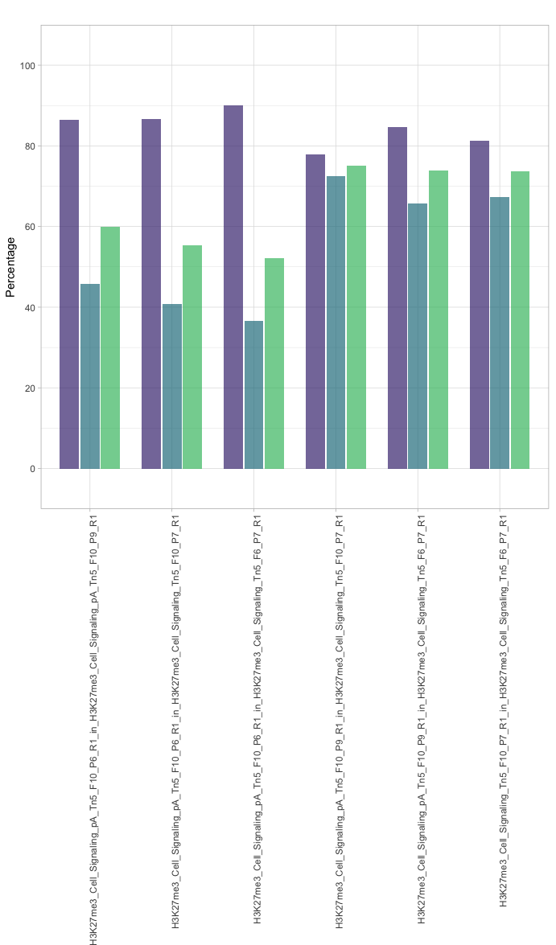
A
B
C
Notes:
Supplementary Figure 3. Pairwise peak comparison between TIP-seq samples. A. Pairwise comparison of bulk TIP-seq peak on H3K27ac. B. Pairwise comparison of single-cell TIP-seq peaks. C. Pairwise comparison of bulk TIP-seq peaks on H3K27me3.

Slide 13
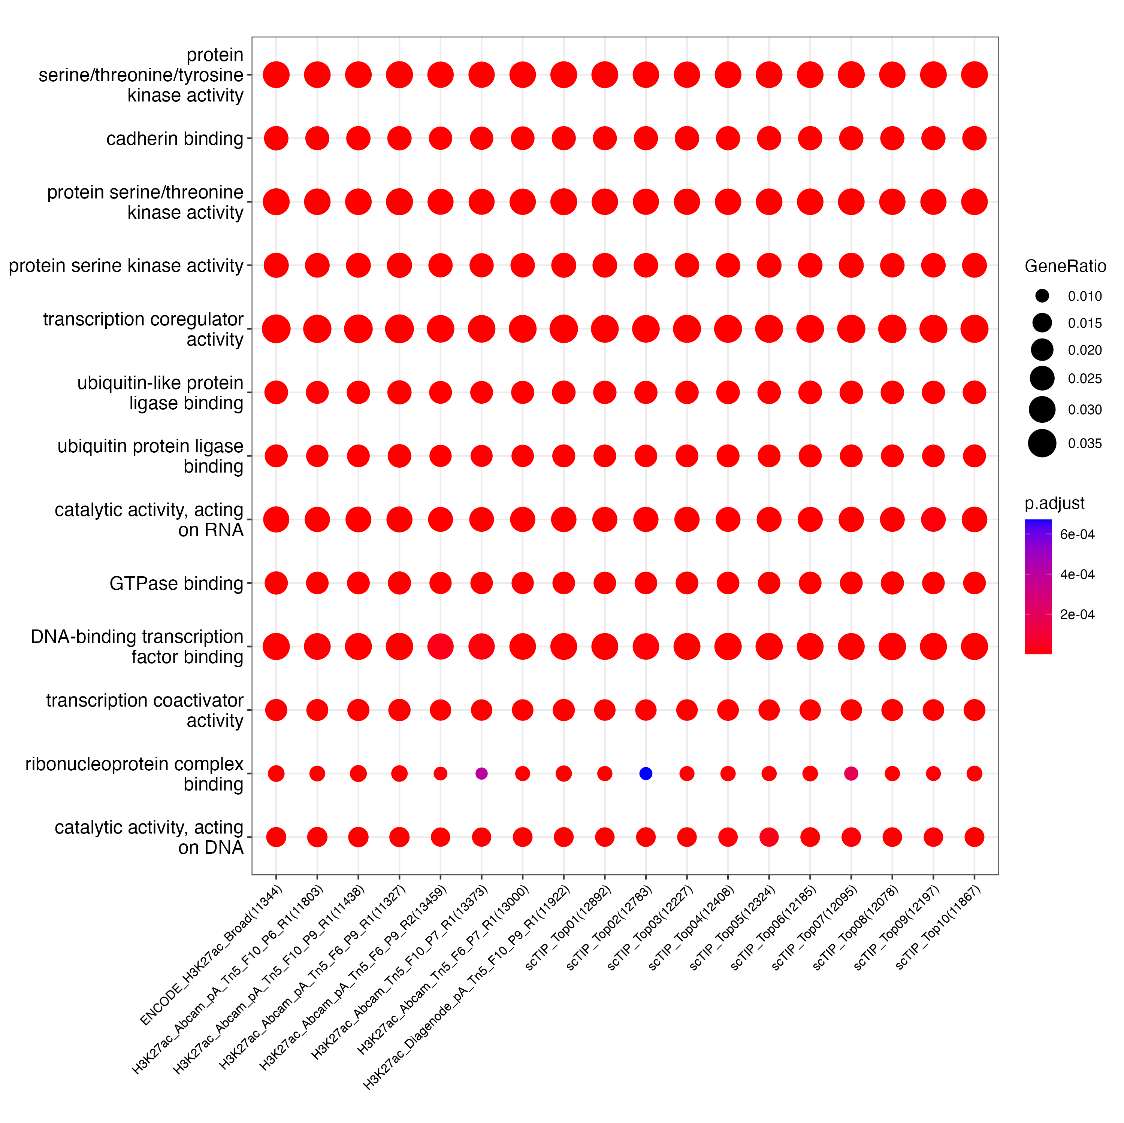
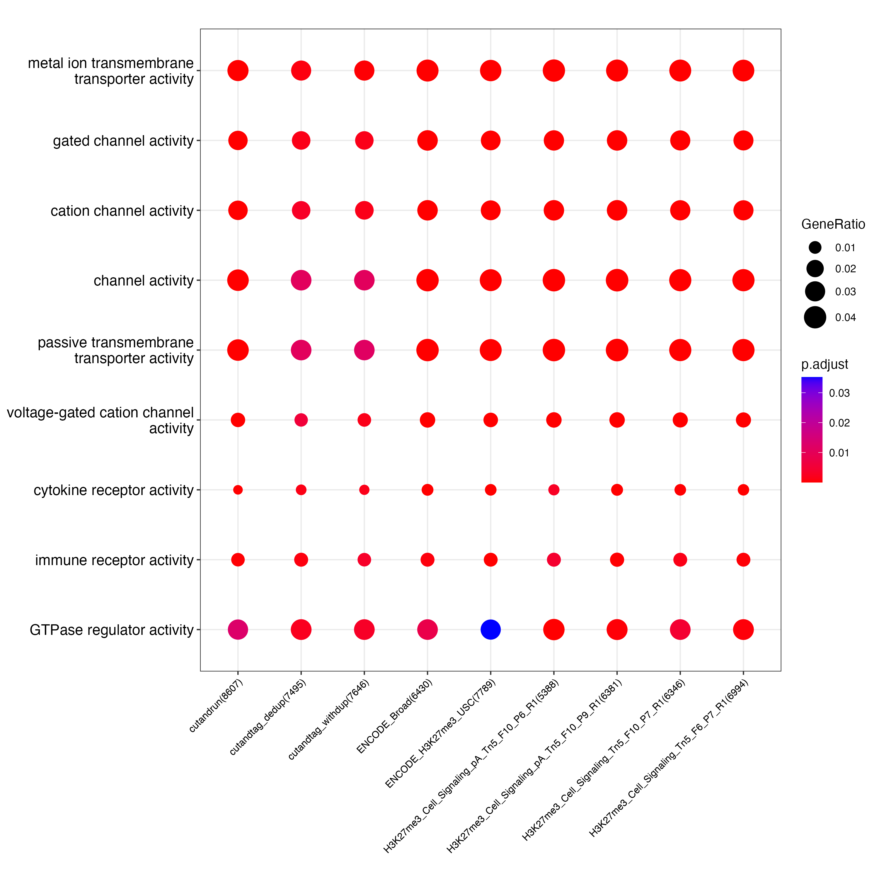
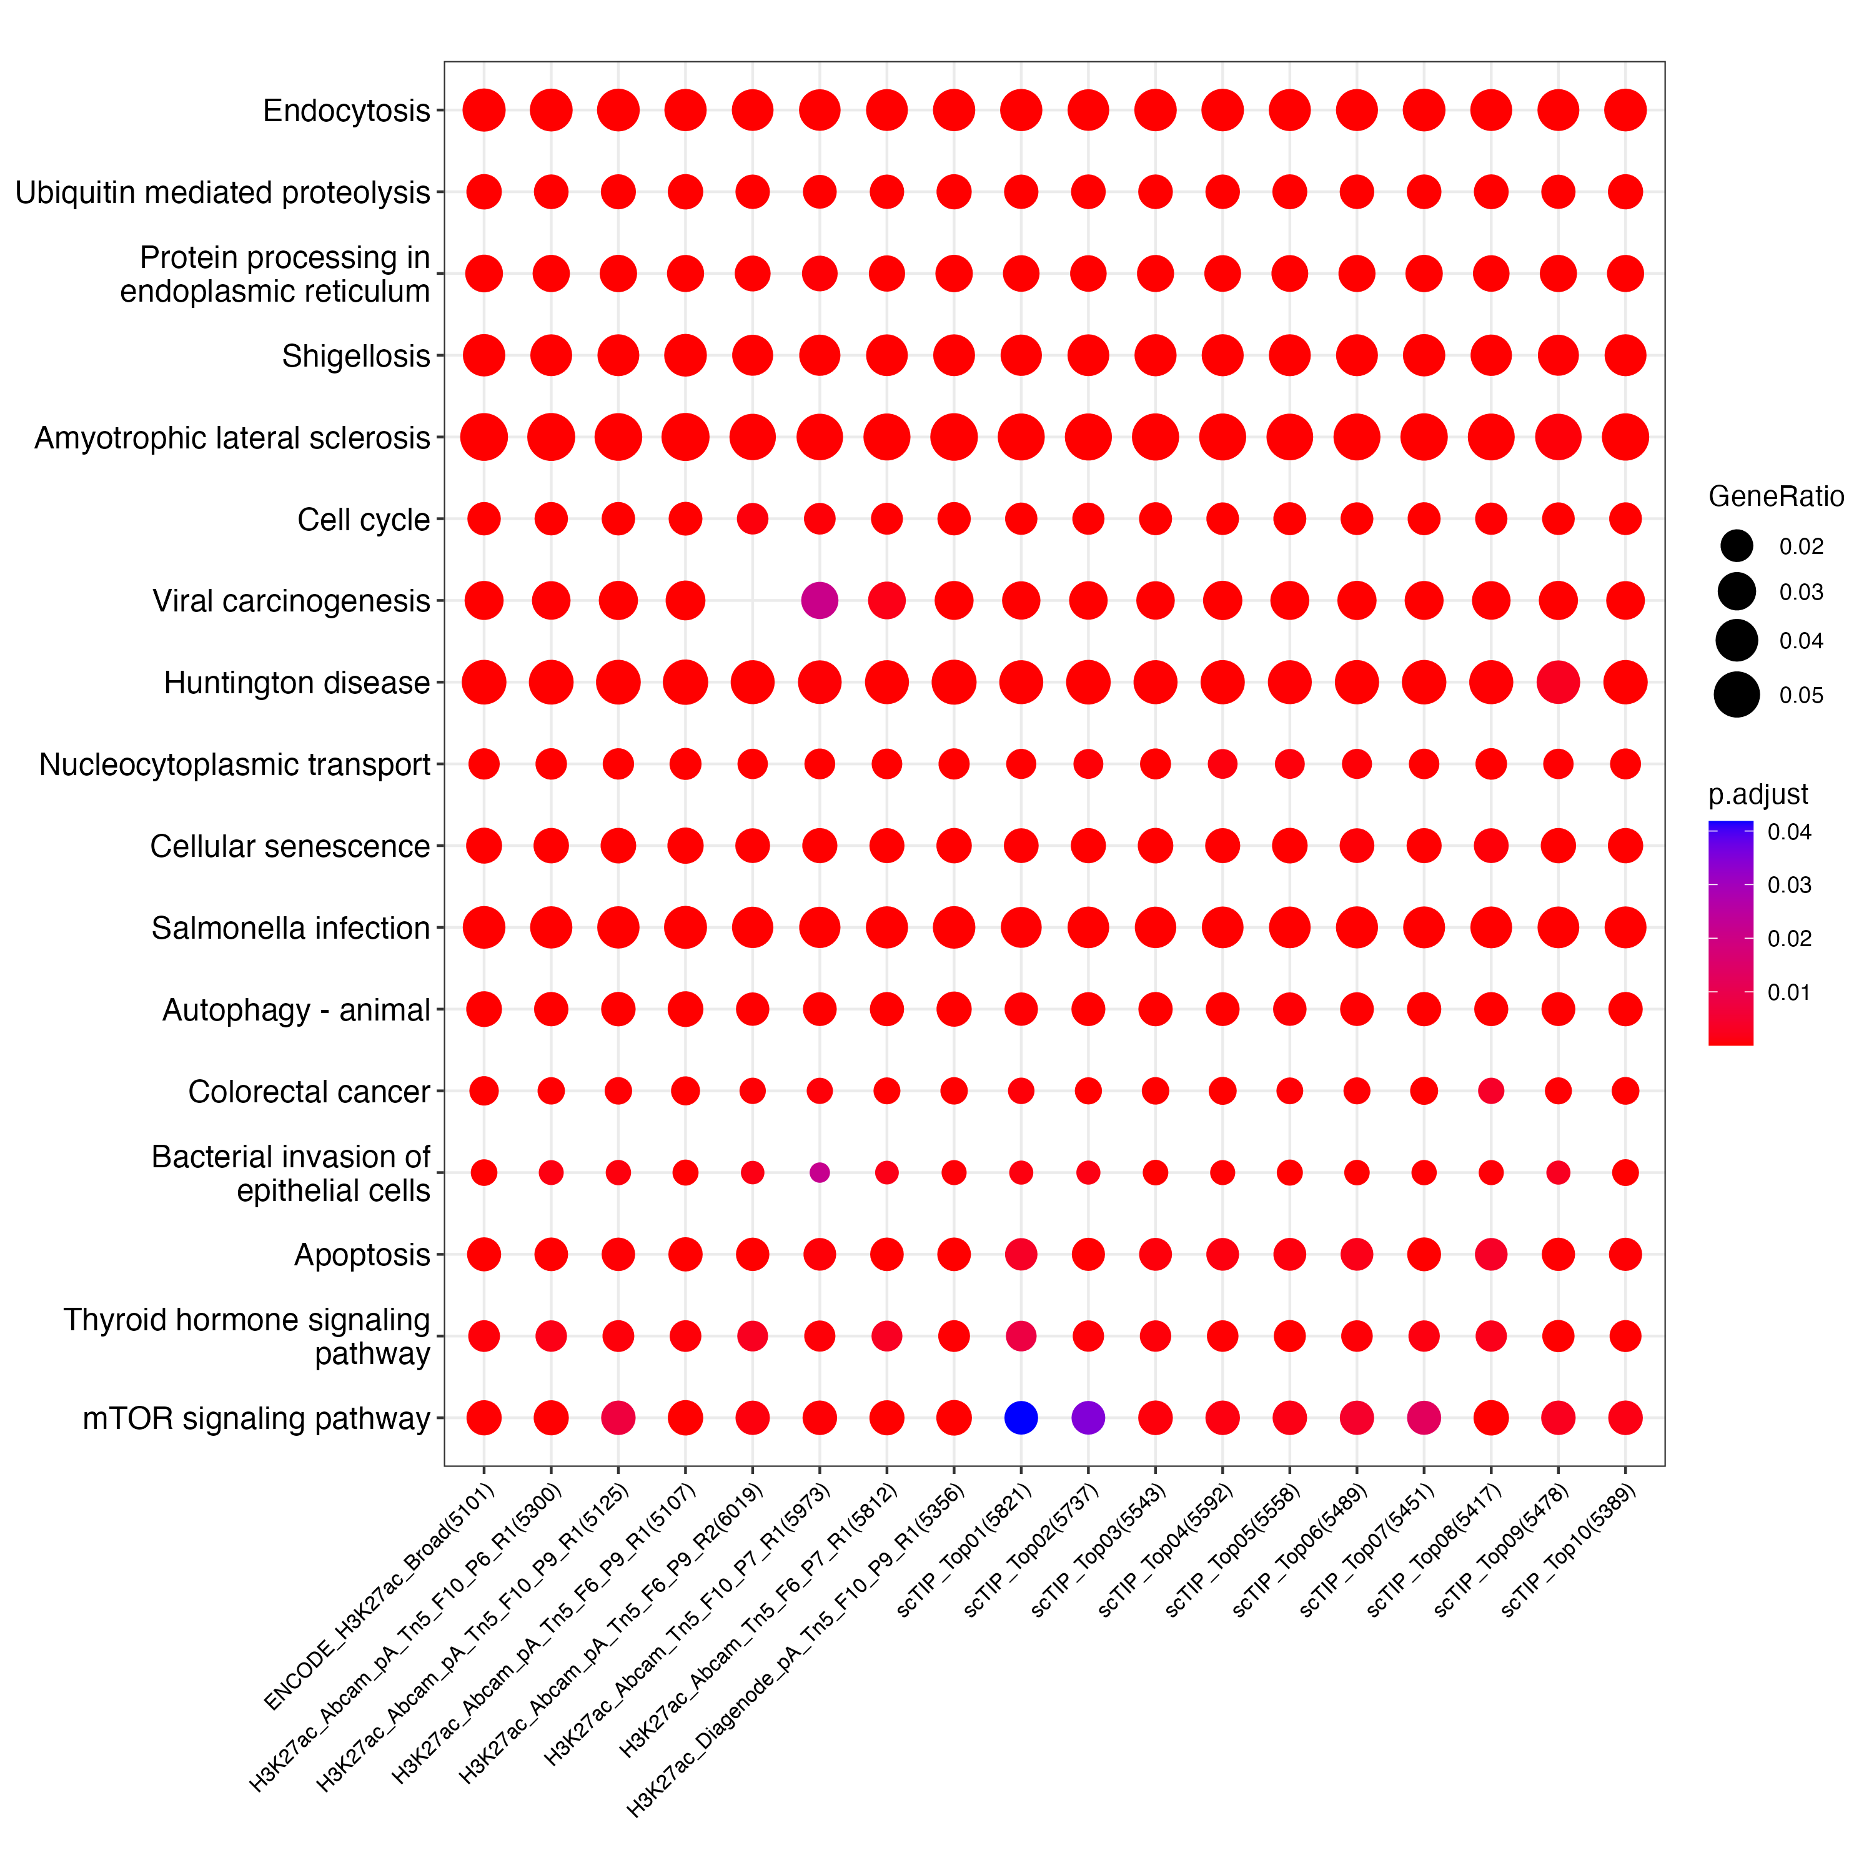
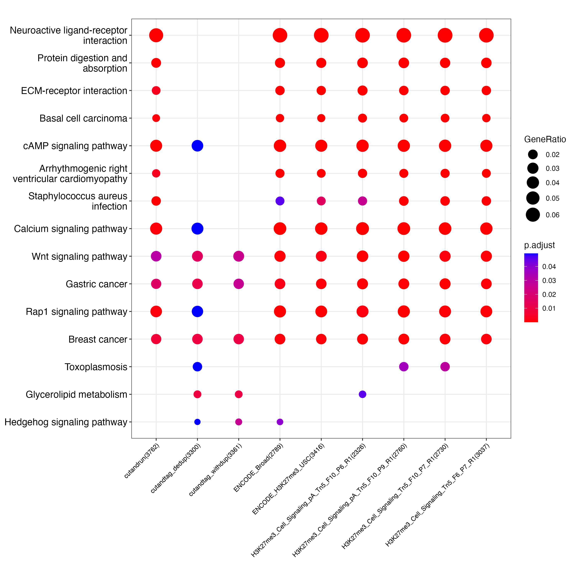
A
B
C
D
Notes:
Supplementary Figure 4. KEGG pathway and GO enrichment analysis show TIP-seq recovers most of the ENCODE reference peak ontology terms for both H3K27ac and H3K27me3. A. Kyoto Encyclopaedia of Genes and Genomes (KEGG) analysis of both bulk and single-cell TIP-seq H3K27ac peaks. B. Gene Ontology (GO) of both bulk and single-cell TIP-seq H3K27ac peaks. C. KEGG analysis of bulk TIP-seq H3K27me3 peaks. D. GO analysis of bulk TIP-seq H3K27me3 peaks.

